Slide 1
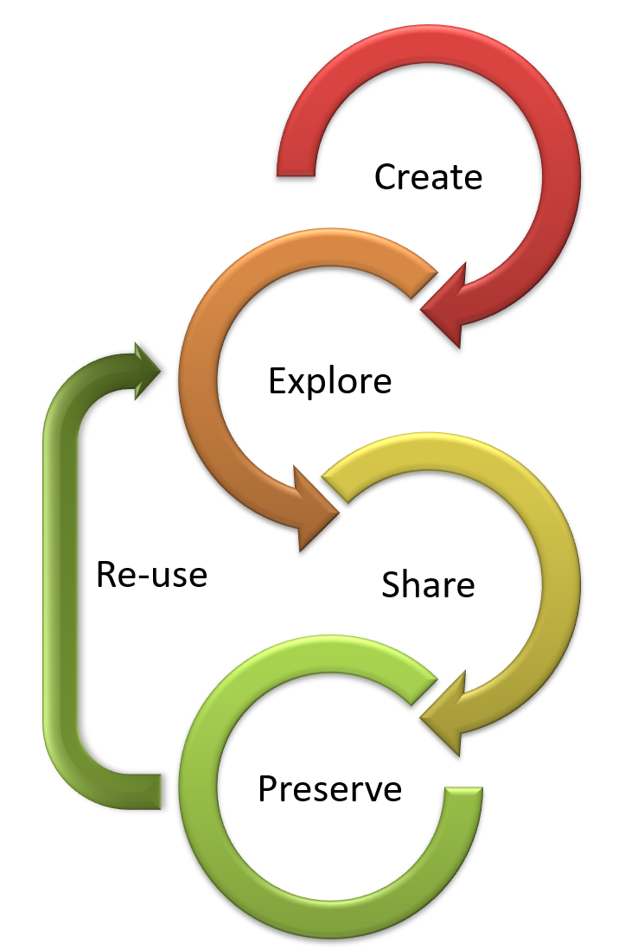

Principles of Research Data Management
Philip Tarrant
Research Data Management Officer
Dr. Stevan Earl
GFL Research Data Manager

Slide 2
Background
OSTP Public Access Memo 2013 - $100M+
Department of Agriculture
Department of Commerce
National Institute of Standards and Technology
National Oceanic and Atmospheric Administration
Department of Defense
Department of Education
Department of Energy
Department of Health and Human Services
Department of Homeland Security
Department of Transportation
Department of Veterans Affairs
Environmental Protection Agency
National Aeronautics and Space Administration
National Science Foundation
Office of the Director of National Intelligence (ODNI)
Smithsonian Institution
US Agency for Int. Development (USAID)
US Geological Survey

Slide 3
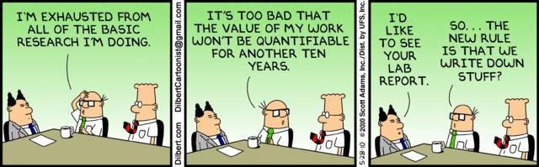
Public access? Research products?
Potentially make available:
Results – publications
Data – raw or derived
Images
Documents
Physical samples
Software
Models
Curriculum content

Slide 4
Reasons to publish
Enable new research – Often more data is needed than one project can collect
Trust – Surveys show public trust is enhanced when data is available
Meet requirements – Journals require submission of supporting data for publication. Funding agencies require data sharing info in prior-support section
Get Credit – Researchers who share data are likely to asked to be co-authors on publications using their data. More frequently cited
Save time – Graduate students are often the most frequent users of a professor’s data. Effective archiving reduces the need to repeatedly locate, share and explain the data
Preserve data – Datasets in a repository have extra consistency checks and formal versioning. Without these characteristics data corruption can go undetected

Slide 5

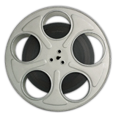
Opinions and facts
The value of interpreting, understanding, and presenting data
“Well, of course we have the best healthcare in the world…”

Slide 6
Opinions and facts
“Well, of course we have the best healthcare in the world…”
 | United States | United Kingdom | Japan
Life Expectancy at Birth (years) | 79.3 | 81.2 | 83.7
Healthy Life Expectancy (years) | 69 | 71 | 75
Maternal Mortality (per 1000) | 12 | 10 | 14
Neonatal Mortality (per 1000) | 4.0 | 2.8 | 1.0
Density of Physicians (per 10k) | 25.5 | 28.1 | 23
Density of Psychiatrists (per 10k) | 1.2 | 1.6 | 1.2
Per Capita Expenditure ($) | 8845 | 3595 | 4787
Source: WHO Global Health Observatory 2017

Slide 7
Improving research data management: What’s the hardest task?
Manage data
Provide technology
Implement processes
Change behavior

Slide 8
Improving research data management: What’s the first task?
Manage data
Key Goal: Make life easier, not harder!
Provide technology
Implement processes
Manage data
Provide technology
Implement processes
Change behavior
Change behavior

Slide 9
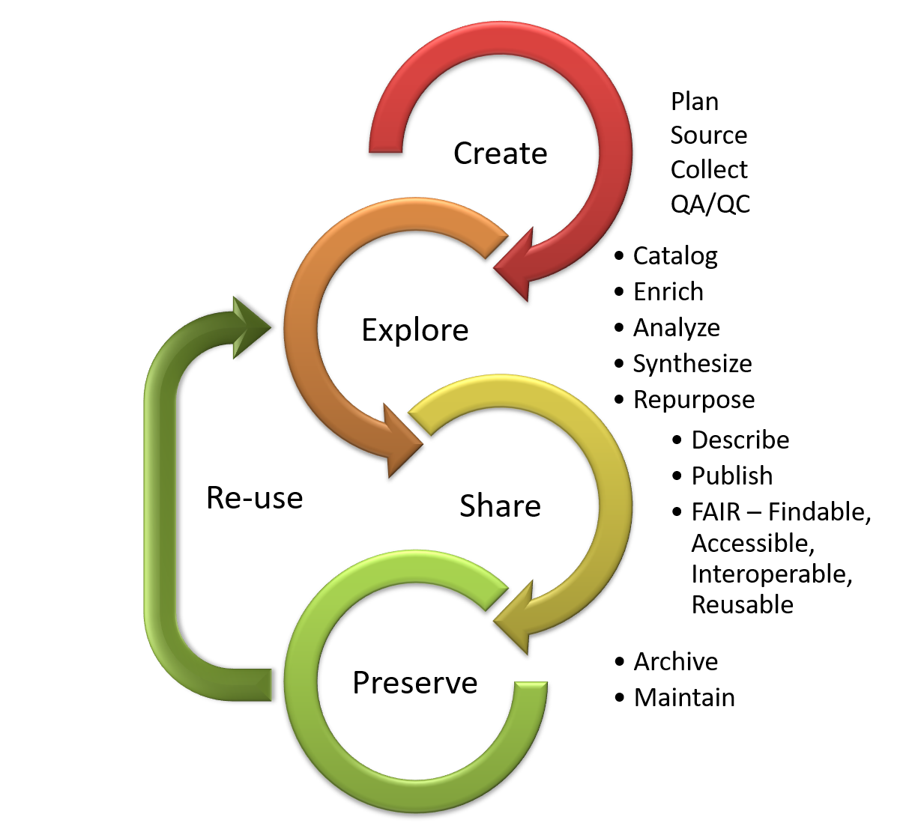
Plan
Research
Publish
Research Community
Knowledge Enterprise
ASU Library
ASU Library
Partnership between Knowledge Enterprise & ASU Library

Slide 10
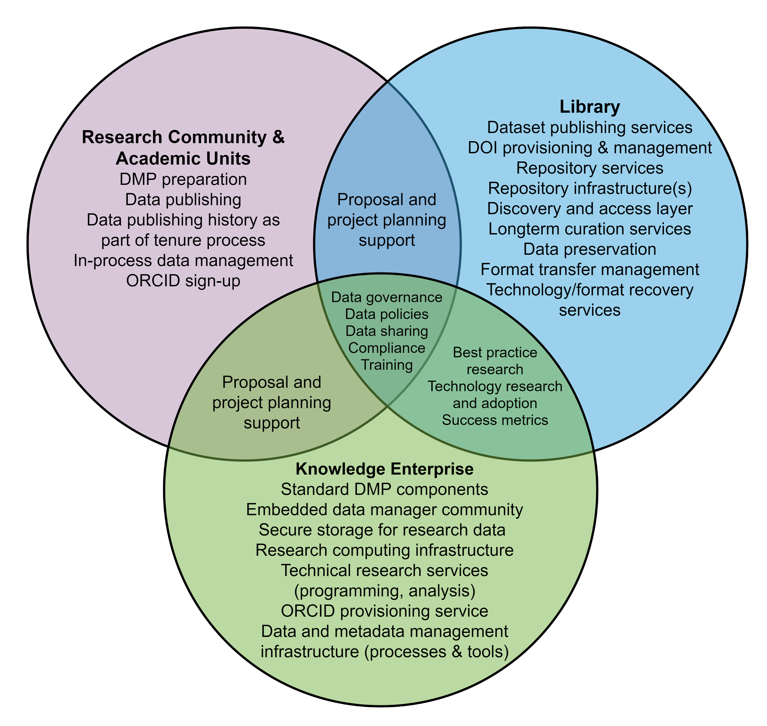
Partnership between Knowledge Enterprise & ASU Library

Slide 11
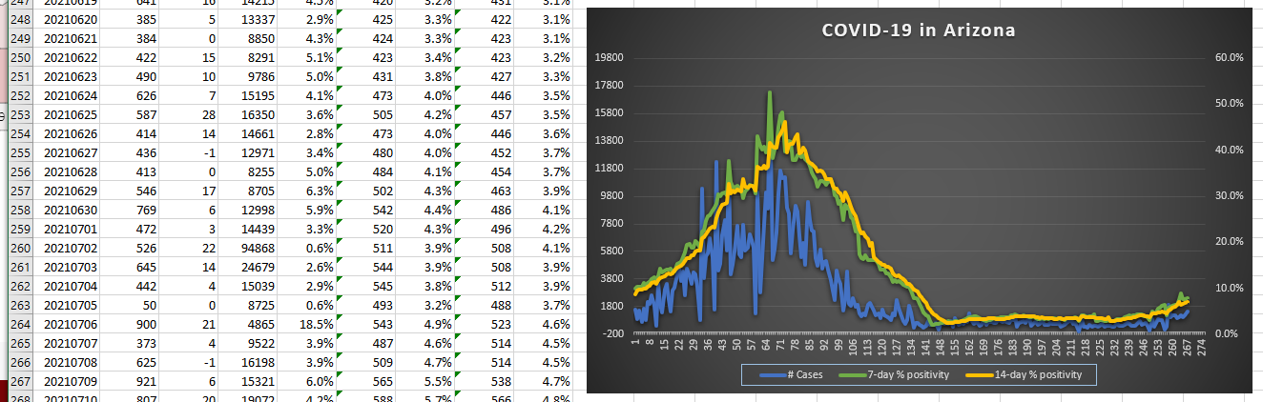
All research creates “data”
Quantitative data: Tabular, spatial, remote sensing
Qualitative data: Documents, survey results, interviews
Supplementary information: e.g. photos, physical samples, recordings

Slide 12
Data are valuable…
Theoretical
Applied
Can be used to:
Support a hypothesis
Provide insight
Enabler for further research
Can be used to:
Solve a problem
Plan for the future
Make better decisions
Improve processes

Slide 13
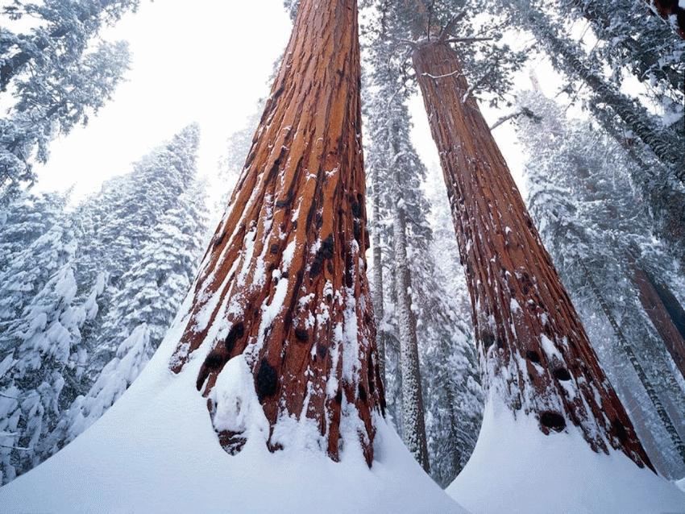
But not without metadata
Tree Specimen | Date | Height
A-1 | 12/05/2012 | 328
B-4 | 12/05/2012 | 291
C-3 | 12/05/2012 | 312
D-5 | 12/05/2012 | 295

Slide 14
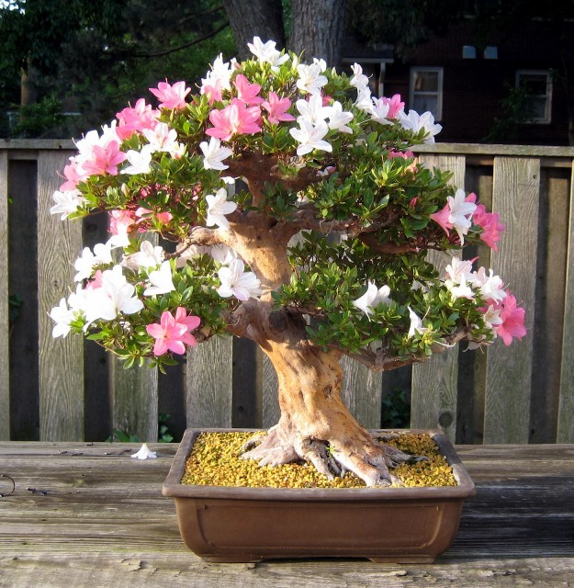
But not without metadata
Tree Specimen | Date (DDMMYYYY) | Height (mm)
A-1 | 12/05/2012 | 328
B-4 | 12/05/2012 | 291
C-3 | 12/05/2012 | 312
D-5 | 12/05/2012 | 295

Slide 15
Recommended Practices

Slide 16

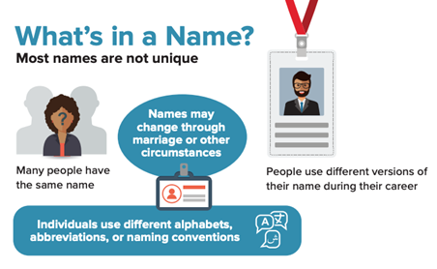
ORCID
What is it?
Your “social security” number for research
Why use one?
Differentiates
Connects
Provides Credit
Saves time
Maintains control

Slide 17
ORCID@ASU
Our plans for ORCID
Encourage adoption
Consider ORCID as a system of record for research activity
Leverage that information in other ASU systems and external systems
What we recommend
Sign up for ORCID if you don’t have one. Affiliate with ASU, if you do
Fill out your ORCID profile using existing content (resume, bibliography, etc.)
Keep information up to date

Slide 18
ORCID@ASU
Our plans for ORCID
Encourage adoption
Consider ORCID as a system of record for research activity
Leverage that information in other ASU systems and external systems
What we recommend
Sign up for ORCID if you don’t have one. Affiliate with ASU, if you do
Fill out your ORCID profile using existing content (resume, bibliography, etc.)
Keep information up to date
https://researchdata.asu.edu/

Slide 20
Tools and Services

Slide 21
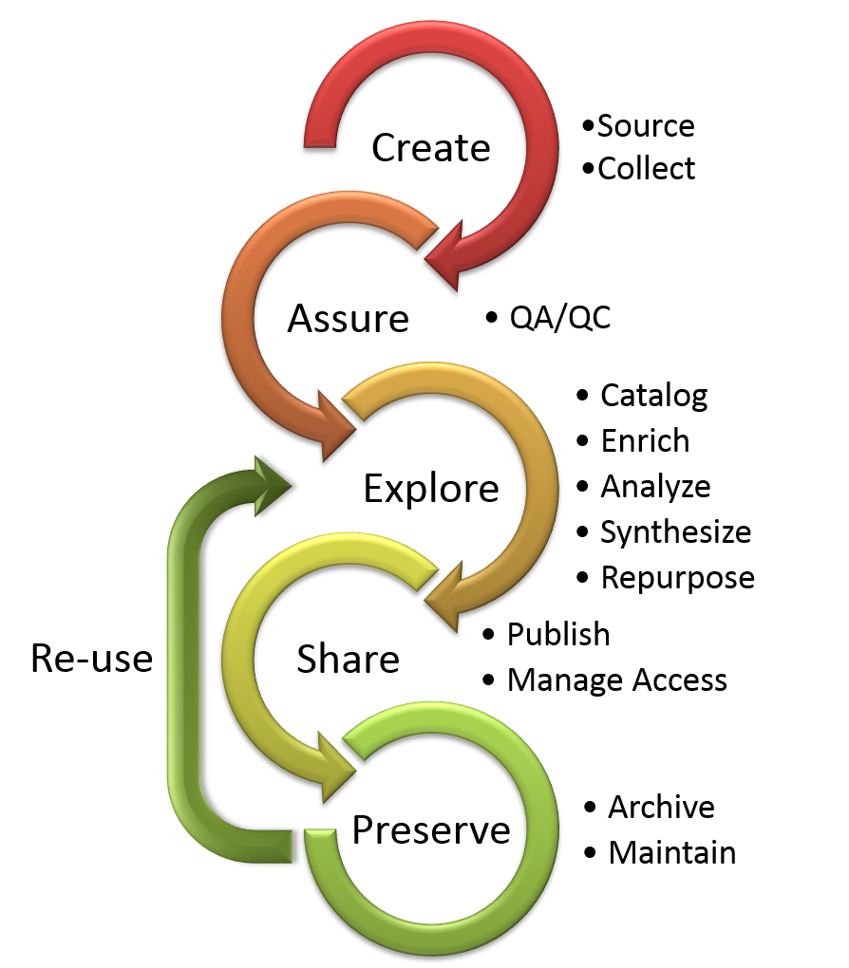
The research data lifecycle
Project start
Project end

Slide 22

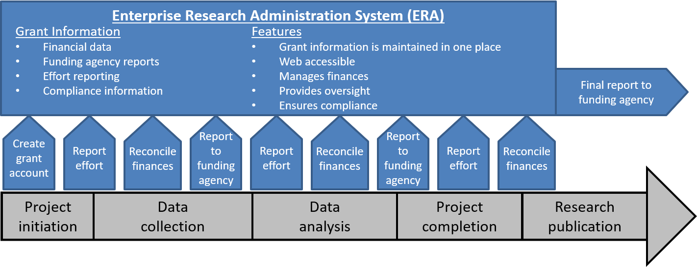

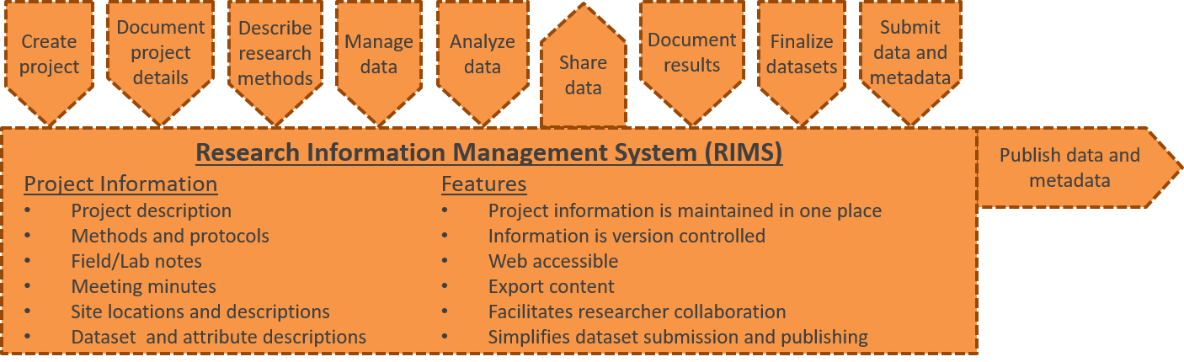
Managing research information
Manage all your research information from one place
Access anywhere, from Windows, iOS and Android devices
Secure, accessed using SSO, encrypted and backed up several times a day
Share notebooks with your research group and even external collaborators
Intellectual property is protected with third party data and timestamps.
Files, photos and documents can be stored within your notebooks
Search using keywords or tags and even by the contents of files
LabArchives meets compliance standards: FDA 21 CFR Part 11, HIPAA, NIST 800-171, GLP, ISO and others

Slide 23
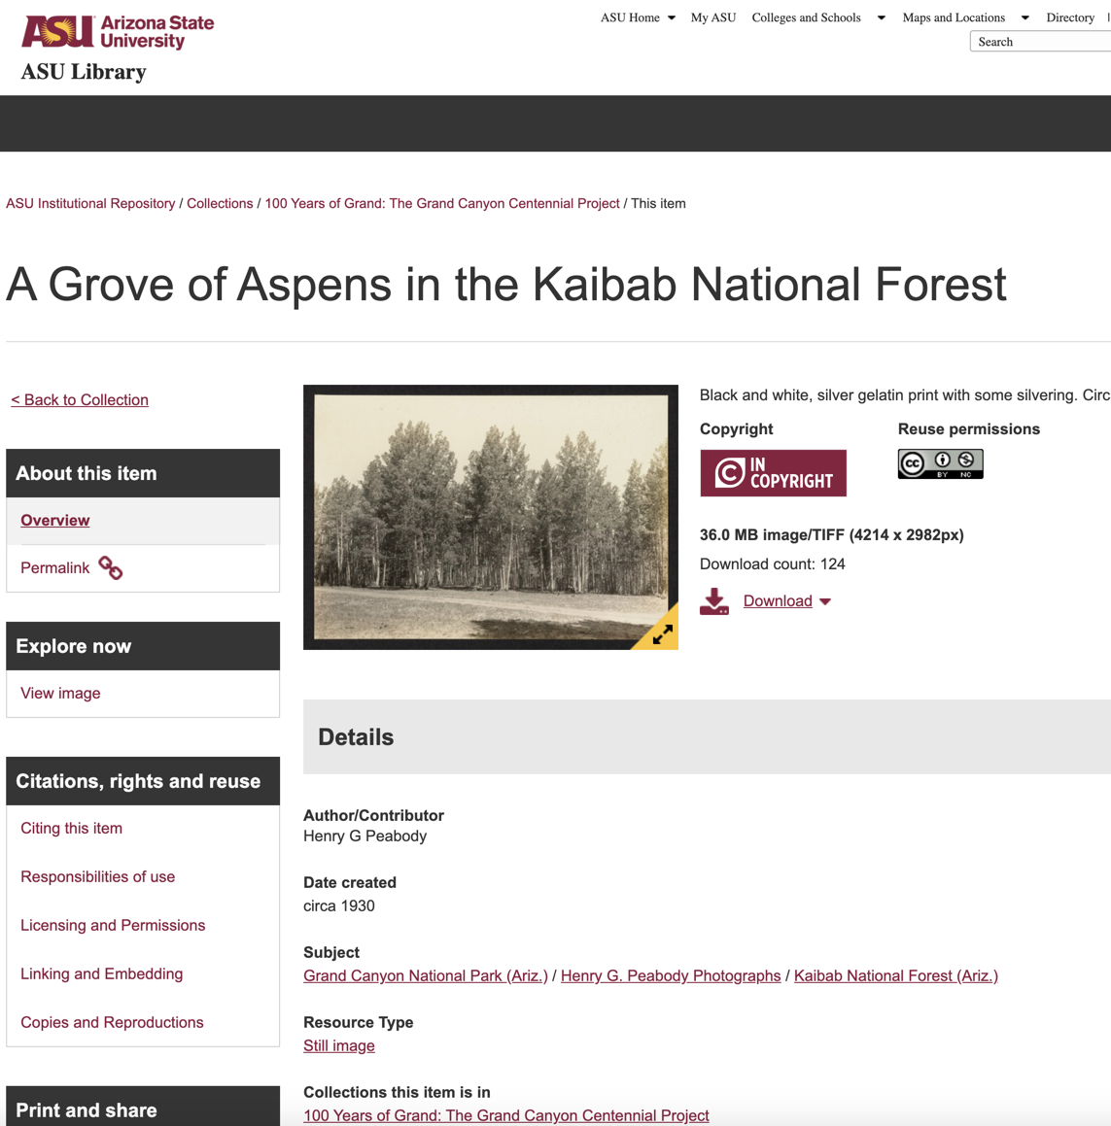

ASU research data repository
Launched in October
Based on Dataverse - well-supported common, repository technology
Publication support provided by library personnel
Now actively looking for faculty publishing opportunities
https://dataverse.asu.edu/

Slide 24
The research data lifecycle
Project start
Project end

Slide 25
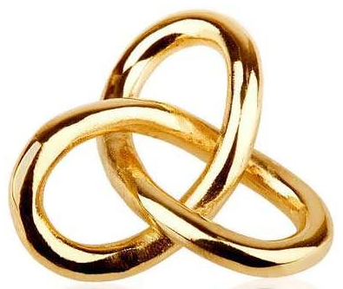
Research data services around the university
Data management planning, i.e. DMPs (KE and Library)
Technology needs assessments (KE)
High performance computing (KE)
ASRE – Arizona Secure Research Environment (KE)
REDCap – Standard REDCap & HIPAA REDCap (KE and CHS)
Scientific programming (KE)
Research data management (KE)
GIS application development (SGSUP)
Bioinformatics (CHS)
Data publishing (Library)
https://researchdata.asu.edu/

Slide 26
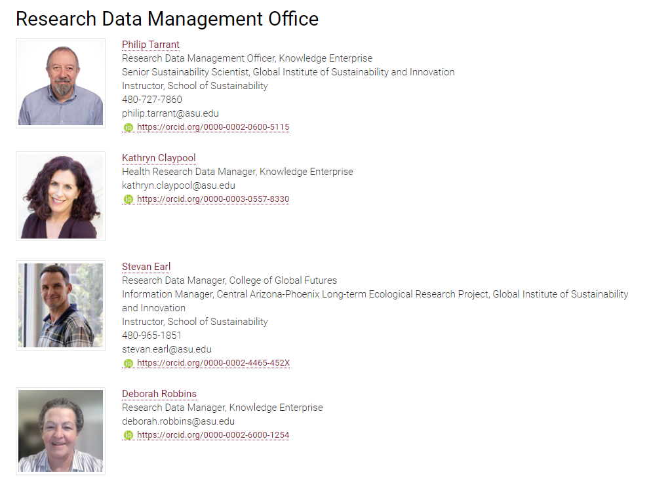
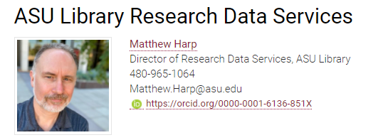


Research data contacts

Slide 27
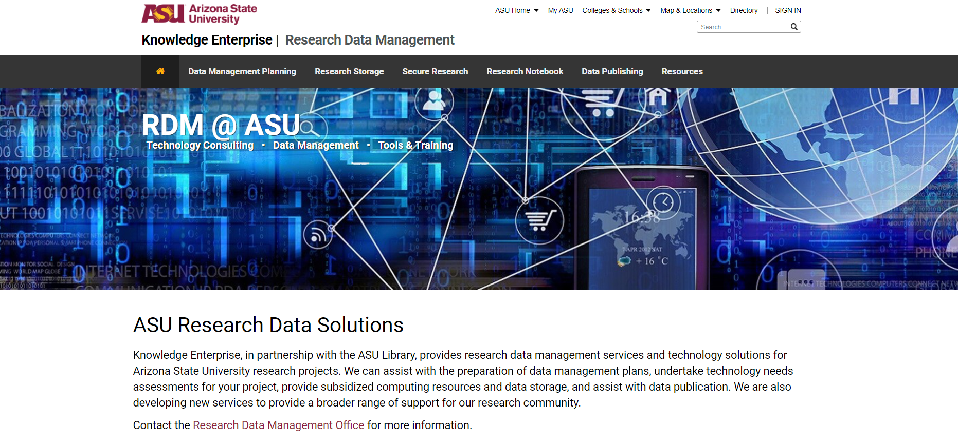
https://researchdata.asu.edu/

